Slide 1
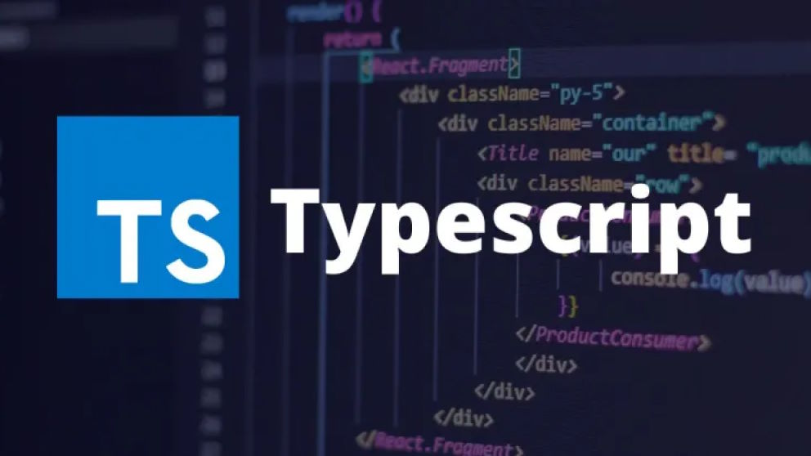
Typescript and its Role in Machine Learning

Slide 2
INTRODUCTION
1. What is Typescript?
Definition: Typescript is a strongly typed superset of JavaScript developed by Microsoft. It builds on JavaScript by adding static typing, object-oriented programming features, and compile-time error checking.
Key Features:
Static typing (type checking during development).
Enhanced IDE support (e.g., IntelliSense in Visual Studio Code).
Compatibility with JavaScript (Typescript code compiles to JavaScript).
Object-oriented programming constructs like classes, interfaces, and modules.

Slide 3
Why is Typescript Used?
Advantages:
Error Reduction: Detects errors at compile-time, reducing runtime errors.
Scalability: Ideal for large-scale projects with multiple developers.
Readability and Maintainability: Explicit types make code more understandable and easier to debug.
Compatibility: Works seamlessly with existing JavaScript code and libraries.

Slide 4
Where is Typescript Used in Machine Learning?
While Typescript is not directly used for training ML models (Python dominates this space), it plays a significant role in the ecosystem around ML. Here’s how:
Frontend Development for ML Applications:
Building interactive dashboards for visualizing ML results (e.g., displaying predictions, charts, and analytics).
Frameworks like React and Angular use Typescript to create user-friendly interfaces for ML-powered tools.
Backend APIs for ML Models:
Used in Node.js to create REST APIs or GraphQL APIs that serve machine learning models to applications.
Example: A Node.js server built with Typescript could handle requests, send data to an ML model hosted elsewhere, and return predictions to the user.

Slide 5
Where is Typescript Used in Machine Learning?
Data Preprocessing and Integration:
Typescript can be used in ETL (Extract, Transform, Load) pipelines for preprocessing data in web-based environments before passing it to ML workflows.
Deployment Platforms:
Typescript is often used to build platforms for deploying models where users can upload datasets, choose algorithms, and view results in real-time.
Visualization Libraries:
Libraries like D3.js and Plotly.js, often used with Typescript, enable rich data visualizations in ML applications.

Slide 6
Why Choose Typescript for ML Applications?
Integration with ML Tools: While Python handles model training, Typescript complements it by handling application layers like APIs and visualizations.
Enhanced Developer Productivity: Features like auto completion, type annotations, and compile-time checks reduce development time and errors.
Ecosystem Compatibility: Works with popular web frameworks and tools commonly used for ML-powered applications.

Slide 7
When Should Typescript Be Used in ML?
Building Dashboards: When you need to visualize ML predictions, trends, or outputs interactively.
Example: Real-time anomaly detection results shown on a web interface.
Serving Models: When deploying an ML model using an API for applications to consume.
Example: A Typescript-based API for sentiment analysis predictions.
Data Wrangling in Web Environments: For lightweight preprocessing of data before sending it to the backend for ML processing.
Team Collaboration: In large teams where code maintainability and readability are critical. Typescript ensures clarity and reduces bugs in complex ML-related projects.

Slide 8
Examples of Typescript in ML Applications
Machine Learning Dashboards:
A web-based dashboard using React + Typescript to visualize predictions from an ML model (e.g., financial forecasts, recommendation scores).
APIs for Predictions:
A Node.js backend written in Typescript that takes user input (like text or images), queries an ML model, and returns predictions.
Interactive ML Tools:
Tools that let users upload datasets, train simple models, and visualize outputs in the browser.

Slide 9
Challenges of Typescript in ML
Not for Model Training: Typescript isn’t suitable for training or developing ML models directly; it relies on Python or R for these tasks.
Learning Curve: Developers familiar with JavaScript might take time to adapt to Typescript's static typing.
Performance: For compute-intensive tasks, Typescript (or JavaScript) is slower than Python or C++.

Slide 10
Conclusion
Why Typescript Matters in ML:
While it doesn’t train models, Typescript is pivotal for building robust, maintainable, and scalable ML-powered applications.
It bridges the gap between complex ML models and user-friendly applications.
Use Cases:
APIs, dashboards, visualization tools, and preprocessing in web environments.
Recommendation:
Use Typescript to complement Python-based ML projects, ensuring seamless integration and better user interaction.

